Slide 1
Machine Learning in Practice I
Lecture 5
Antal Jakovac, 2025

Slide 2
Probability and information theory basics

Slide 3

Information theory basics
Practical probability theory (adapted to ML):
possible outputs of an event: sample space
features (→ random variables): functions,
observe a list of events:
probability: → histogram
distribution:
probability density:

Slide 4
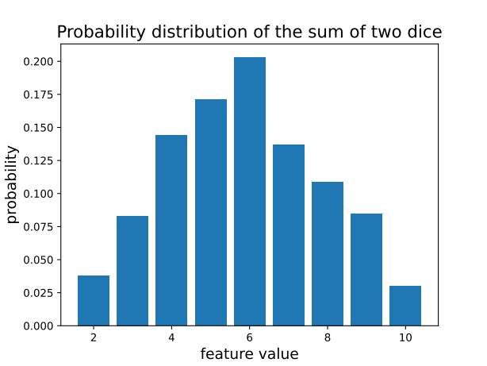
Information theory basics
example of 2 dice thrown N times
# generate data
Ndata = 1000
data = np.random.randint(1,6,size=(Ndata,2))
feature = data[:,0] + data[:,1]
# measure histogram
fmax = int(max(feature))
fmin = int(min(feature))
bins = np.zeros(fmax-fmin+1)
for f in feature:
bins[int(f-fmin)] += 1
bins/=Ndata
# show result
fig,ax = plt.subplots()
ax.bar(np.arange(fmin,fmax+1),bins)
ax.set_xlabel('feature value', fontsize=14)
ax.set_ylabel('probability', fontsize=14)

Slide 5
Information theory basics
Joint probability distributions
the features can have several components →
their distribution is called joint probability distribution:
if we are interested only on one component:
for independent features the value of x does not depend on the value of y

Slide 6
Information theory basics
Information theory: statistical relation of measurements
assume we have measured a lot N→∞
allows simplifications → Stirling formula:
measure of the uncertainty / unpredictability / impurity of a probability distribution → Shannon entropy

Slide 7
Information theory basics
Shannon entropy: measure of variability of a distribution
perform N measurements with n possible outputs (bins)
count the number of results in each bin:
how many realizations is possible for a given ?
Shannon entropy: log of this number over N
equivalent to the entropy concept in physics: number of microstate representation of a macrostate

Slide 8
Information theory basics
Shannon entropy:
take n bins, N independent measurements
we obtain → probability
how many ways can this distribution be realized?
(measurements within a bin are indistinguishable)
binomial – multinomial expression

Slide 9
Information theory basics
Shannon entropy:
information theory: → for all parts
Stirling formula, using
Shannon entropy:

Slide 10
Information theory basics
Shannon entropy:
always positive or zero
minimal for a pure sample
maximal for uniform sample
convex

Slide 11
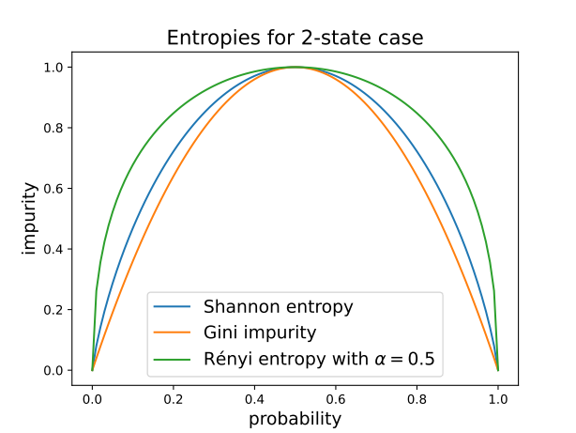

Information theory basics
Other entropy formulae:
we assumed independence of measurement bins
what if they are not (non-additive systems)
general definition using properties
(positive, convex)
examples:
  Rényi-Tsallis entropy
  Gini impurity

Slide 12
Information theory basics
Shannon entropy and amount of information
we have n events with probabilities
define information as the minimal number of questions needed to find out which one happened? → twenty questions game
answer: Shannon entropy!
  one question → one “bit” of information
  Shannon entropy = information content
  for uniform probabilities logarithmic search, in general Huffmann coding

Slide 13
Information theory basics
Shannon entropy and amount of information – technical slide
coding: a binary code corresponds an interval in [0,1)
can be placed non-overlapping if (Kraft–McMillan theorem)
choose code lengths → non-overlapping
average code length

Slide 14
Information theory basics
Shannon entropy and amount of information
example for Huffmann coding
average questions:
0.4+3x0.6=2.2
Shannon entropy:
2.12

Slide 15
Information theory basics
Joint probability, entropy and mutual information
if states depend on two variables, the joint probability
for independent variables
the corresponding Shannon entropy
measure of independence: mutual information

Slide 16
Information theory basics
Joint probability, entropy and mutual information
example: 2 bits
# Shannon entropy function
def SH(p):
return -p*np.log2(p+1e-10)
pX = np.sum(p0, axis=1)
pY = np.sum(p0, axis=0)
pXY = np.reshape(p0, -1)
allH = []
for p in [pXY,pX,pY]:
H = 0
for pi in np.reshape(p, -1):
H += SH(pi)
allH.append(H)
IXY = allH[1] + allH[2] - allH[0]

Slide 17
Information theory basics
Joint probability, entropy and mutual information
example: 2 bits
# example: independent case
p0=[[ ¼, ¼ ], [¼, ¼]]
pX = [½, ½]
pY = [½, ½]
# note that pXY = pX*pY
HX = 1
HY = 1
HXY = 2
IXY = 0
# Shannon entropy function
def SH(p):
return -p*np.log2(p+1e-10)
pX = np.sum(p0, axis=1)
pY = np.sum(p0, axis=0)
pXY = np.reshape(p0, -1)
allH = []
for p in [pXY,pX,pY]:
H = 0
for pi in np.reshape(p, -1):
H += SH(pi)
allH.append(H)
IXY = allH[1] + allH[2] - allH[0]

Slide 18
Information theory basics
Joint probability, entropy and mutual information
example: 2 bits
# example: independent case
p0=[[ ¼, ¼ ], [¼, ¼]]
pX = [½, ½]
pY = [½, ½]
# note that pXY = pX*pY
HX = 1
HY = 1
HXY = 2
IXY = 0
# Shannon entropy function
def SH(p):
return -p*np.log2(p+1e-10)
pX = np.sum(p0, axis=1)
pY = np.sum(p0, axis=0)
pXY = np.reshape(p0, -1)
allH = []
for p in [pXY,pX,pY]:
H = 0
for pi in np.reshape(p, -1):
H += SH(pi)
allH.append(H)
IXY = allH[1] + allH[2] - allH[0]
# example: not independent case
p0=[[ 1/3, 1/6 ], [¼, ¼]]
pX = [½, ½]
pY = [7/12, 5/12]
# note that pXY not = pX*pY
HX = 1
HY = 0.98
HXY = 1.96
IXY = 0.02

Slide 19
Information theory basics
Probability of the observed sample
we randomly choose case i with probability
what is the probability that we observe events from class i?
logic of the result:
  first we choose event 1, next event 2, etc. →
  number of such events is
  probability

Slide 20
Information theory basics
Probability of the observed sample
logarithm of the result in the N→∞ case
Kullback-Leibler divergence:
interpretation: “distance” of probability distributions

Slide 21
END OF LECTURE 5

